Slide 1
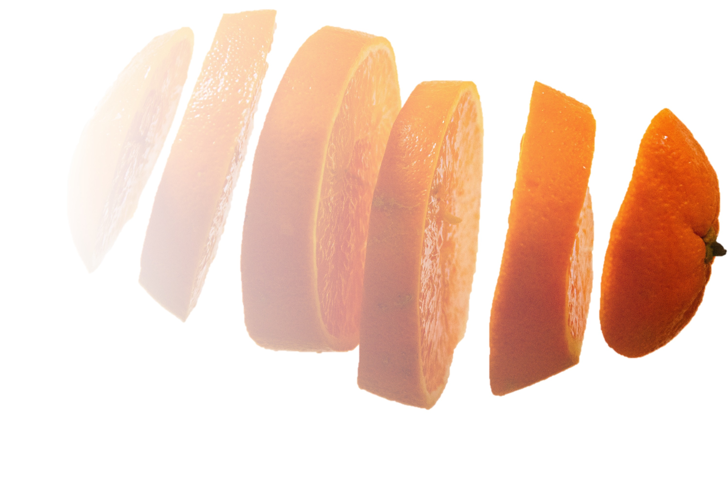

Open Science for Grad Students
Grace Shearrer, PhD
Department of Nutrition
University of North Carolina, Chapel Hill

Slide 2
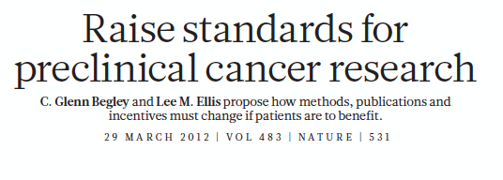
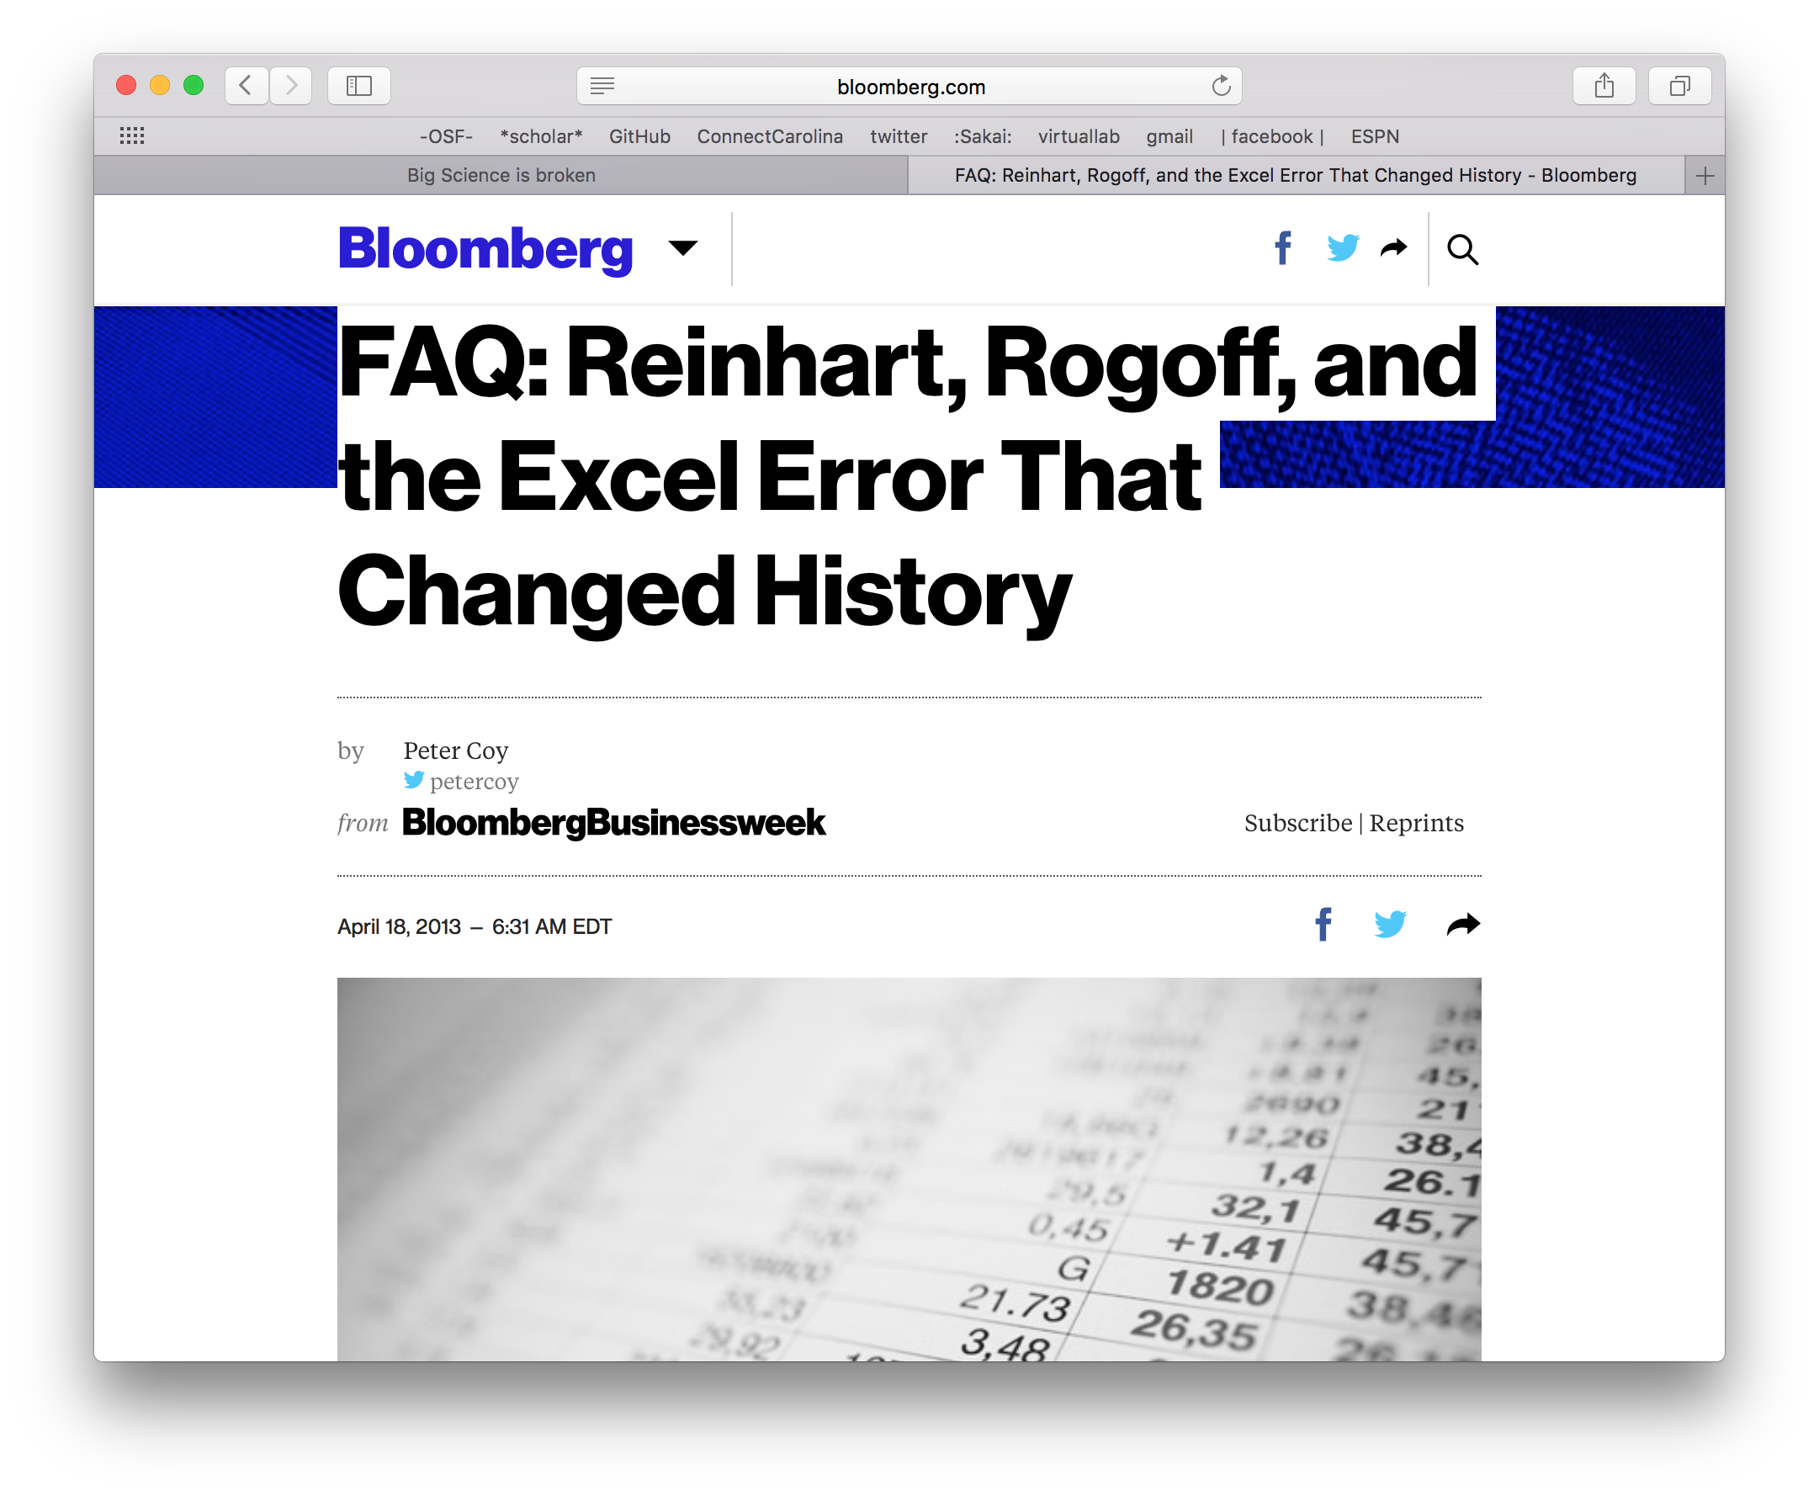
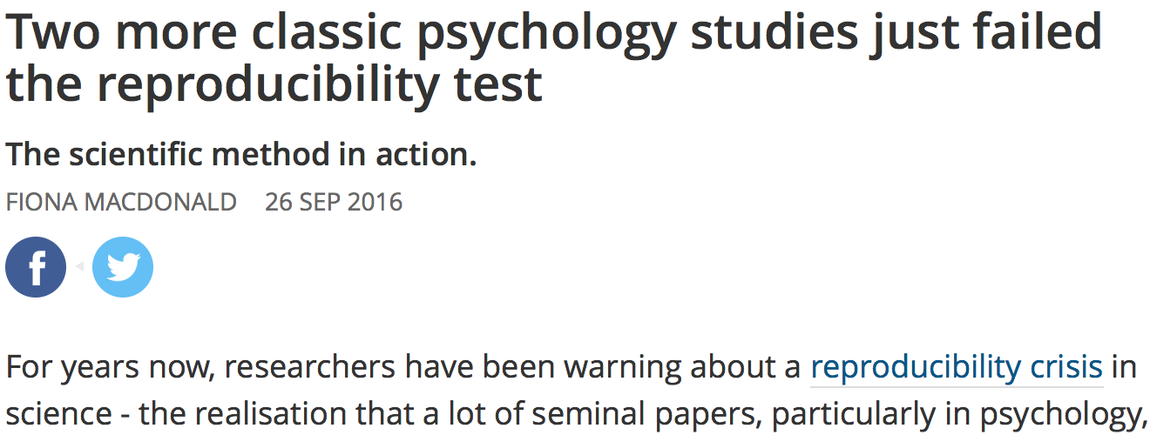
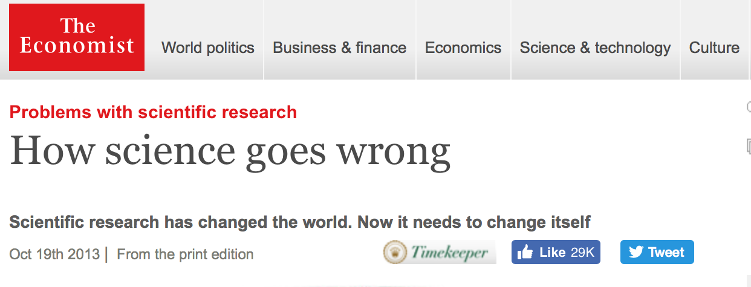
Our field is a mess, but why?
Good news we aren’t alone

Slide 3
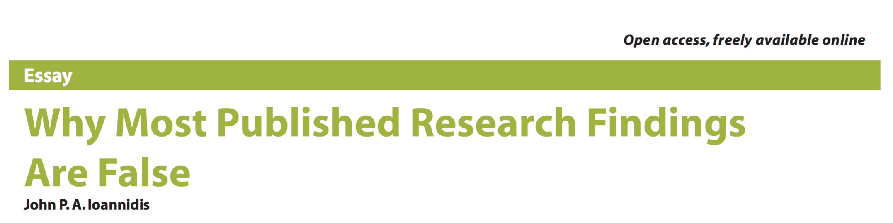
File draw phenomena
Smaller studies = less likely to be true findings
Smaller effect sizes = less likely to be true
Increased # of tests, reductionist focus = less likely
Increased flexibility in methods = less likely
Greater financial interests = less likely
Greater public interest = less likely

Slide 4
What if I told you
Lack of reproducibility
Same methods, same data
Lack of replication
Same methods, different sample
Reproducibility & Replication of results enable us to trust the evidence, not source
Brain’s talk

Slide 5
The super easy way to do not great things
Data dredging
P-hacking
What about discovery science I want to play with my data???
That’s great, play and learn, the issue is defining the temporal precedence of what you set out to do.
Posthoc is not a bad word.

Slide 6
Norms
The backward norms of science
#dysfunctionalinscentive
Counternorms
Communality
Open sharing
Universalism
Evaluate research on own merit
Disinterestedness
Motivated by knowledge and discovery
Organized skepticism
Consider all new evidence, even against one’s prior work
Quality
Secrecy
Closed
Particularlism
Evaluate research by reputation
Self-interestedness
Treat science as a competition
Organized dogmatism
Invest career promoting one’s own theories, findings
Quantity
Notes:
Communality – open sharing with colleagues; Secrecy
Universalism – research evaluated only on its merit; Particularism – research evaluated by reputation/past productivity
Disinterestedness – scientists motivated by knowledge and discovery, not by personal gain; self-interestedness – treat science as a competition with other scientists
Organized skepticism – consider all new evidence, theory, data, even if it contradicts one’s prior work/point-of-view; organized dogmatism – invest career in promoting one’s own most important findings, theories, innovations
Quality – seek quality contributions; Quantity – seek high volume

Slide 7
Transparency as collective action problem
So what can I do?

Slide 8



Signals: Making Behaviors Visible Promotes Adoption
Notes:
Badges
Open Data
Open Materials
Preregistration
Psychological Science (Jan 2014)

Slide 9
Registeration
Design
Collect & Analyze
Report
Publish
PEER
REVIEW
Notes:
Review of intro and methods prior to data collection; published regardless of outcome
Beauty vs. accuracy of reporting
Publishing negative results
Conducting replications
Peer review focuses on quality of methods

Slide 10
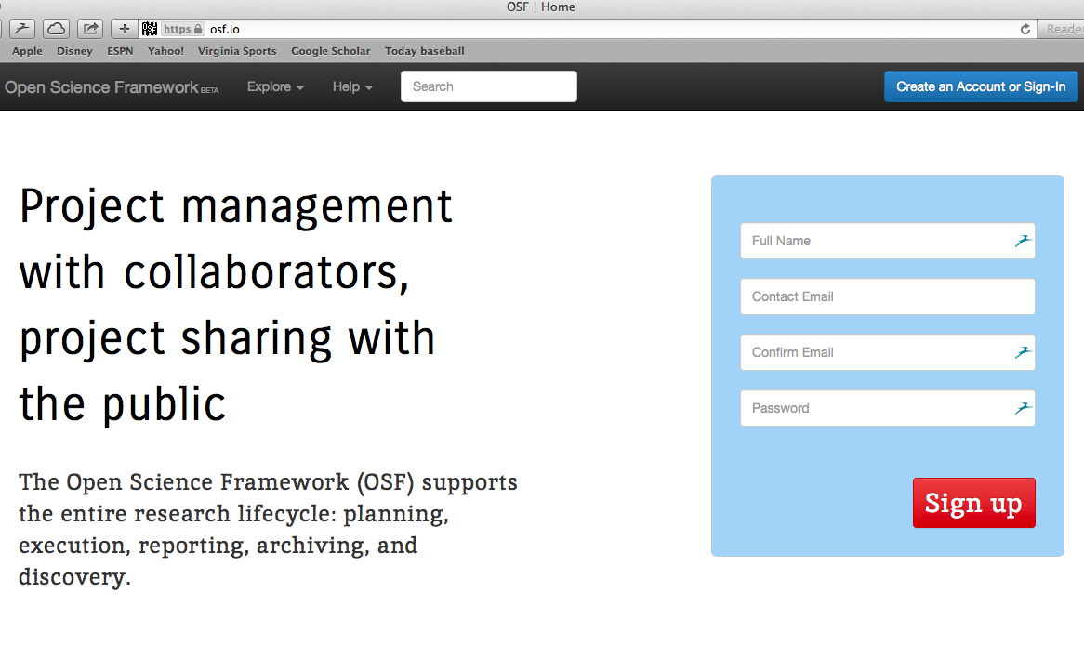
Open Science Framework
http://osf.io/
Notes:
Share data, share materials, show the research process – confirmatory result make it clear, exploratory discovery make it clear; demonstrate the ingenuity, perspiration, and learning across false starts, errant procedures, and early hints – doesn’t have to be written in painstaking detail in the final report, just make it available.

Slide 11

Publish report
Search and discover
Write report
Develop idea
Interpret findings
Design study
OSF
Analyze data
Acquire materials
Store data
Collect data
Notes:
Workflow – level of abstraction that is shared across areas of scholarly inquiry, particularly the sciences
Functions that support that workflow

Slide 12




















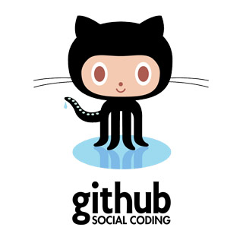




OSF
Notes:
Authoring
Publishers
Repositories
Acquisition
Analysis Tools
Discovery Tools
Google scholar
Impactstory
Twitter
IRB
Grants

Slide 13
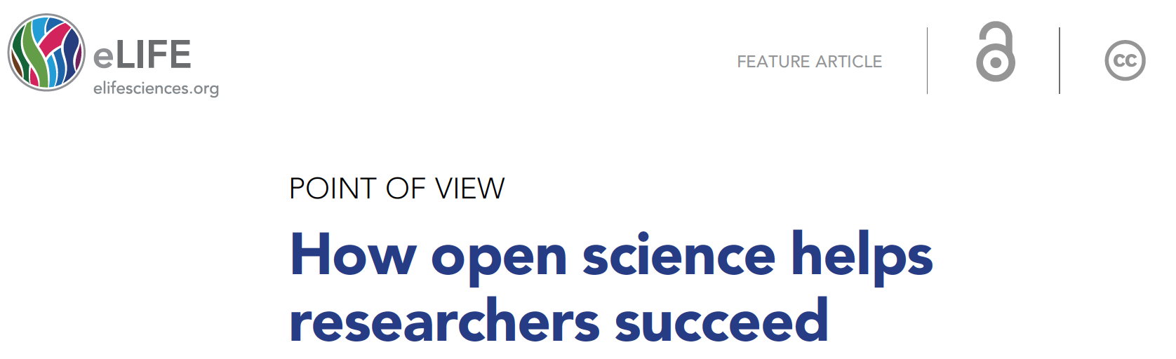
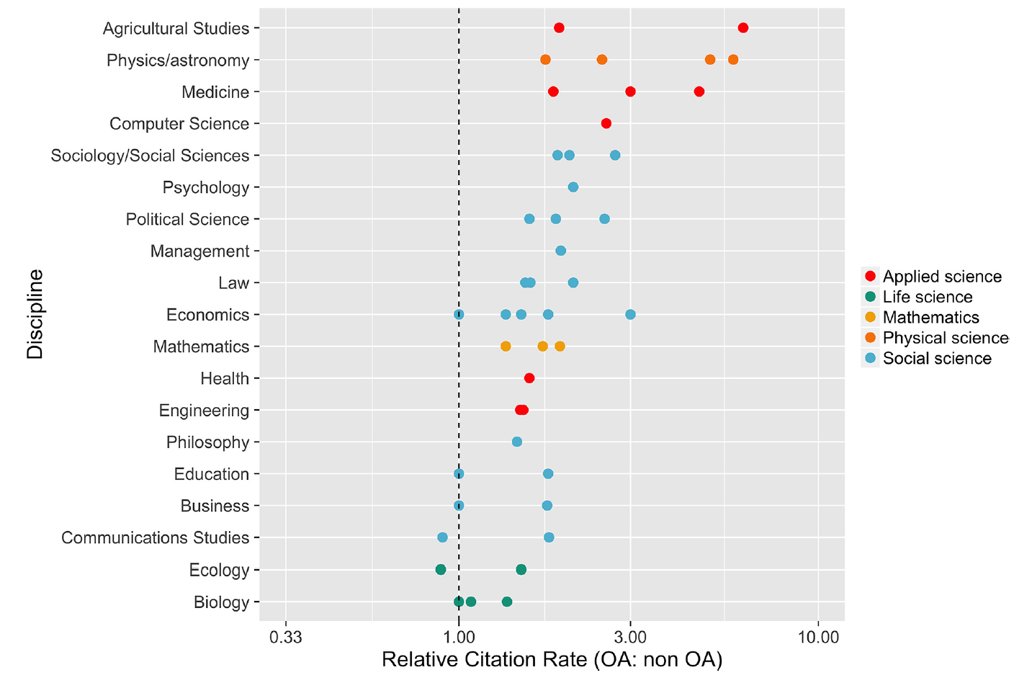
Can open science help early careers?
Increased transparency
increases the value of your
question, your critical thinking
and your methods (your scientific value) and
decreases emphasis of any given result (null or otherwise)
Notes:
~25% had applied for one or more badges
1st preregistration badge earned in November but not in print yet

Slide 14
Let’s give it a try
https://osf.io/dashboard

Slide 15
Open Materials Will SAVE YOU

Slide 16
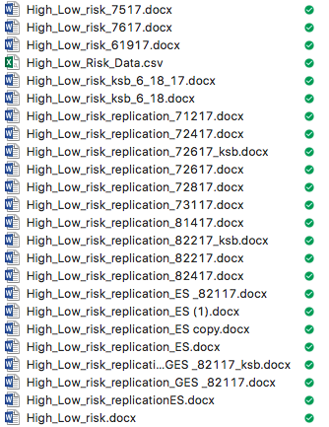
Version Control
Old Fashion way

Slide 17
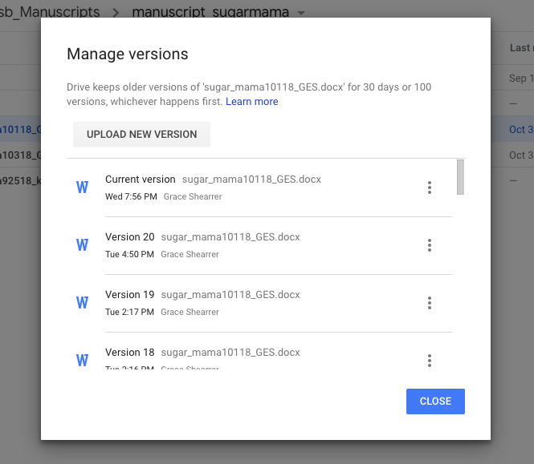
Version Control
THE CLOUD

Slide 18

Git
Version control your code!
Agnostic to type of code
Python
R
SPSS
SAS
MATLAB
Requires minimal linux knowledge

Slide 19
Git Started
Find your terminal command
Go to https://github.com/
git clone <your repo name>
This is going to copy the whole repo
git remote -v
git remote add <ease to remember handle> <html to the repo on github>

Slide 20
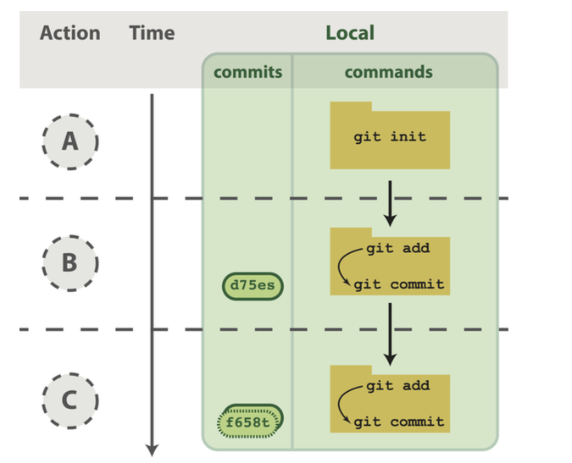
Git Started
Make a .git folder
Start tracking
Git add <filename>
Start tracking this file
Git commit -m “useful note”
What did I just do…

Slide 21
Git Remote
Now we have made local changes and saved them in our .git folder
Want to put them on the internet!

Slide 22
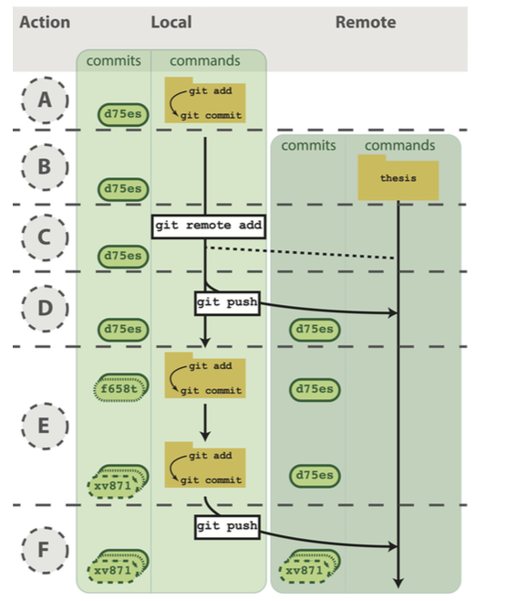
Git Remote
Push to the internet!

Slide 23
Why do all this?
When you mess up your code, every version is still available
git checkout <old commit number>

Slide 24
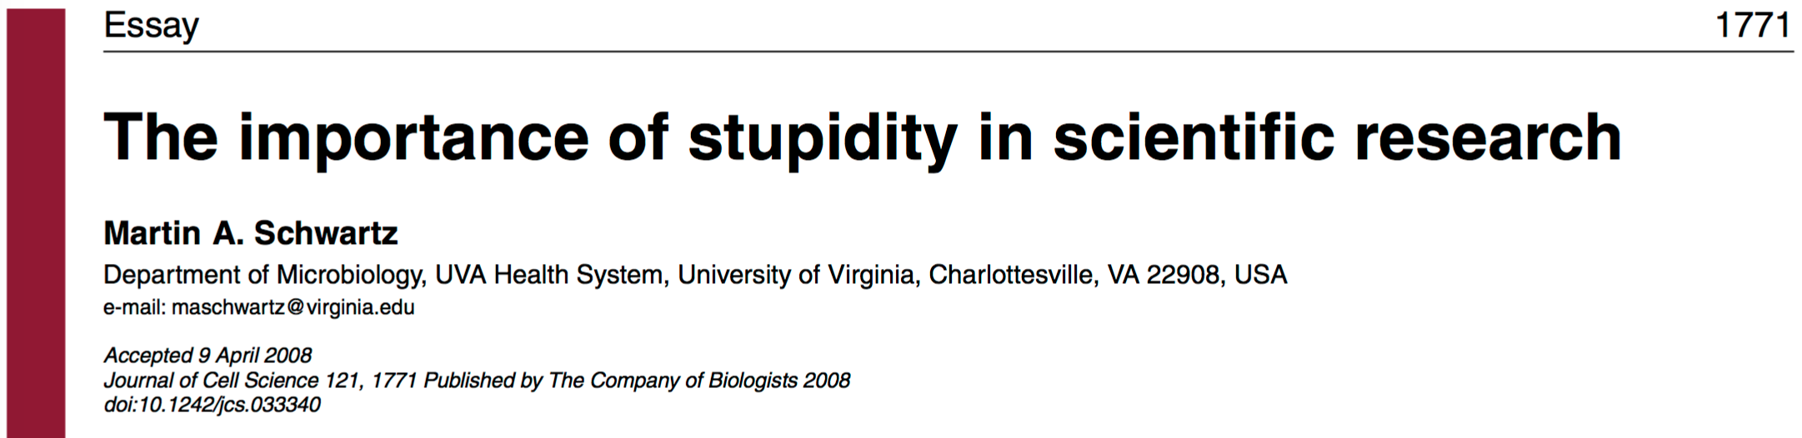
What can we do to promote reproducible (open) science?
Be stupid
Come to the table with your question
Always have a question and write it down
Be open with and proud of your methods
Focus on the process and not product
What I’m doing www.NIBLunc.org
Notes:
~25% had applied for one or more badges
1st preregistration badge earned in November but not in print yet

Slide 25
So why did you get into science?

